Slide 1
Boston Police Overtime D
Sponsor: City of Boston
Project Motivation: Potentially save taxpayer dollars and improve efficiency of the Boston police system
Goal: To identify trends in police overtime misuse with actionable evidence
Background: The BPD operates with a budget exceeding $400 million, and understanding how this budget is distributed is of paramount importance to ensure accountability, transparency, and to address potential issues of financial excess and wasteful spending.
By: Aaron Zheng, Rithik Bhandary, Chen Yang, Jakob Rundlett

Slide 2
Work done so far:
Division of Work:
Each of us took one of the four datasets and worked on them and upon completion of the current dataset, we took a dataset of our choice and continued extracting information from them.
We met biweekly to set goals and update each other with our individual progress.
Datasets Used:
1. Employee earnings data (search police) - This dataset contains information on the earnings of all employees of the City of Boston, including job title, name, department name, regular pay, gross pay, injury pay, “other pay” and overtime pay.
2. Campaign contribution data - This dataset has information on the contributions made to the house representatives, senator and CC contributions, with a focus on contributions made by the police force.
3. BPD field activity data - Spanning from 2011 to 2022, this dataset details interactions between the Boston Police Department (BPD) and the public via three record management systems: OLD RMS, NEW RMS, and MARK43. It sheds light on the frequency and duration of stops, highlighting specific officers and supervisors involved. The data aids in recognizing patterns, potential discrepancies, and mapping active officers and supervisors using key variables like 'stop_duration', 'contact_officer', and 'supervisor'. It offers a comprehensive view of BPD's field activities and trends over the years.
4. Overtime data from 2012-2022 - This dataset provides valuable information to discover the discrepancies between the amount of authorized overtime hours and the amount of hours actually worked. Also, it provides insights on the overtime details for the duty performed by the police in the Court.

Slide 3
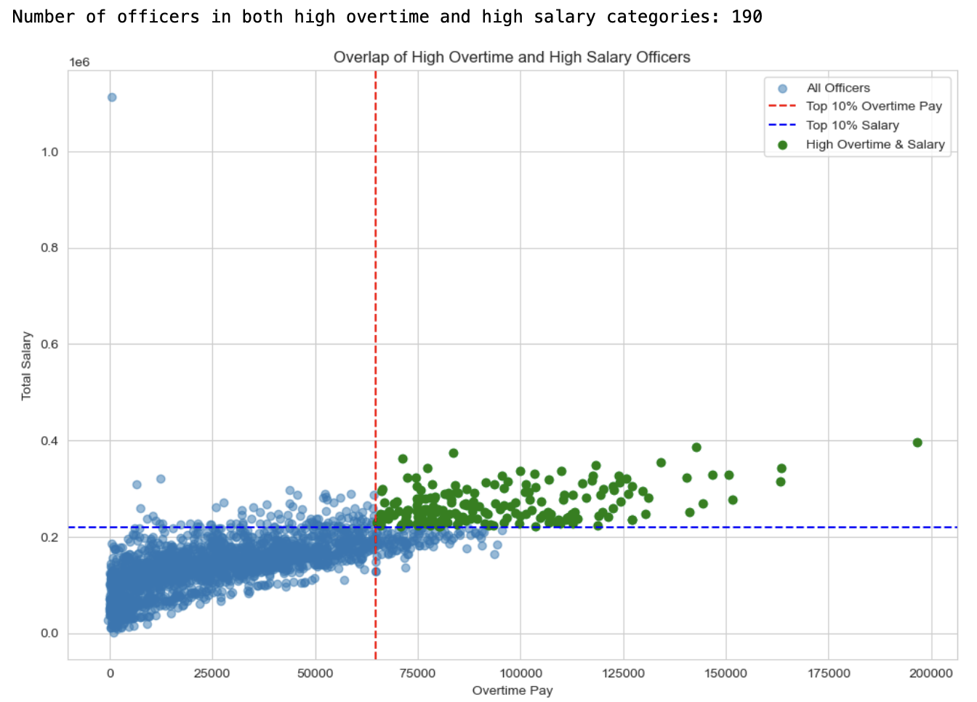
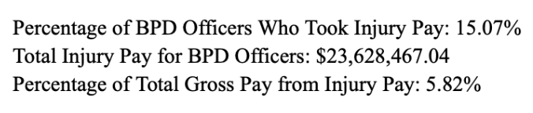
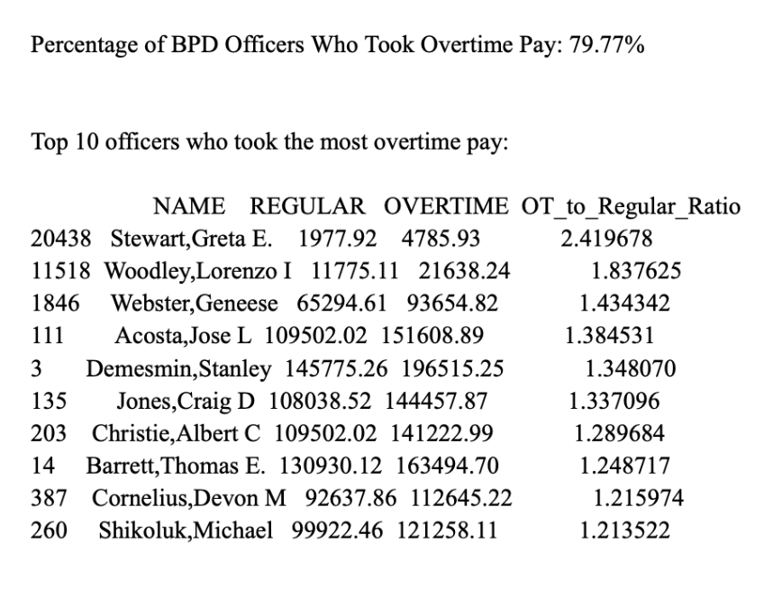
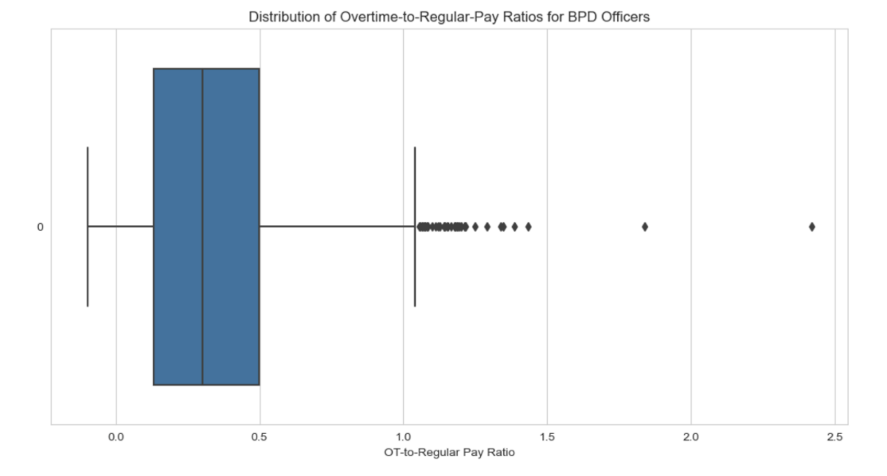
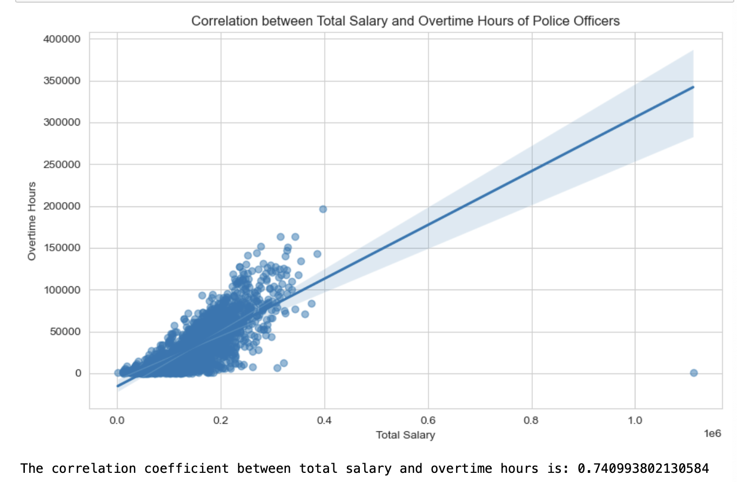
Observations:
Performed analysis on the earning-data.csv dataset which includes general earnings data for city of Boston employees.

Slide 4
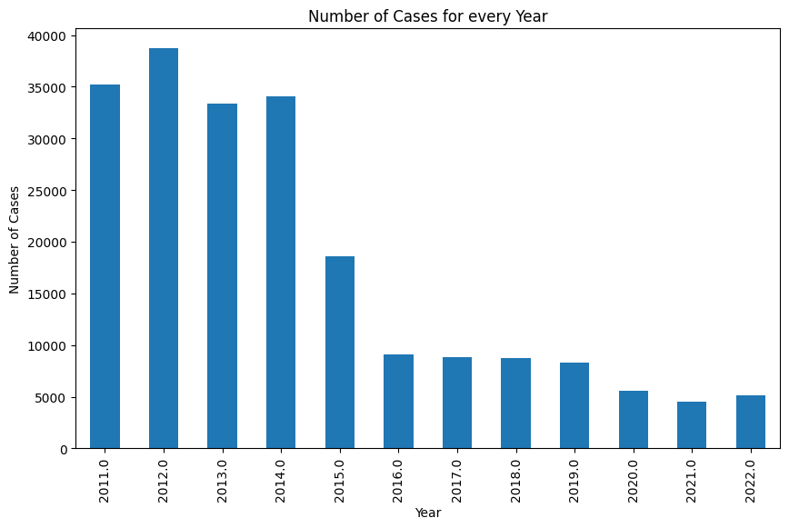
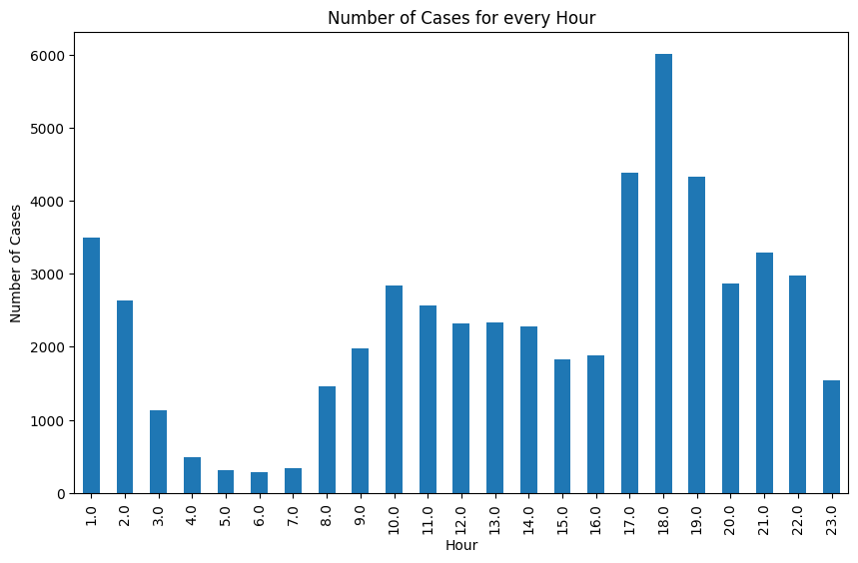

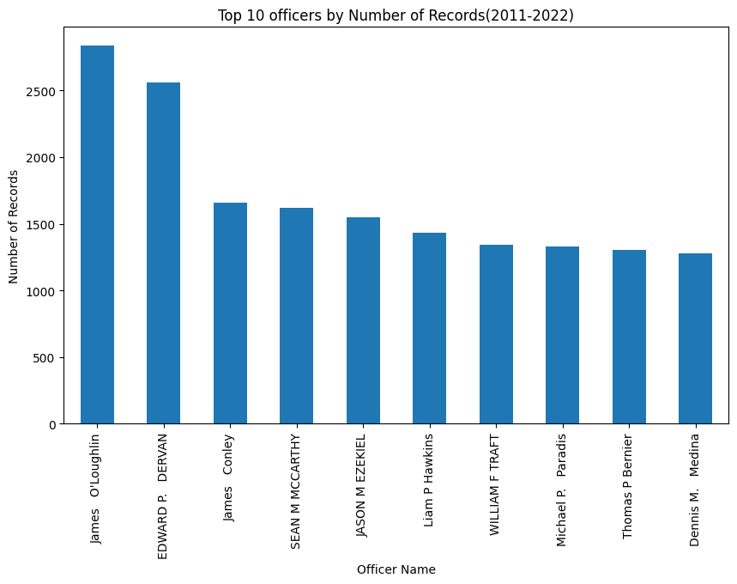
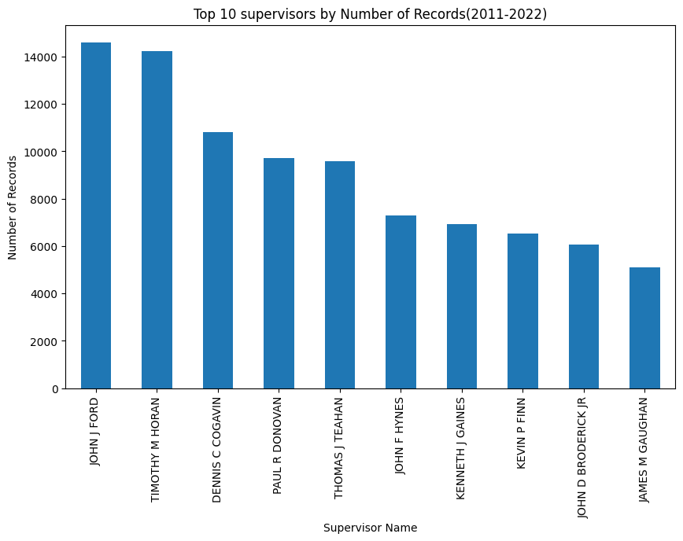
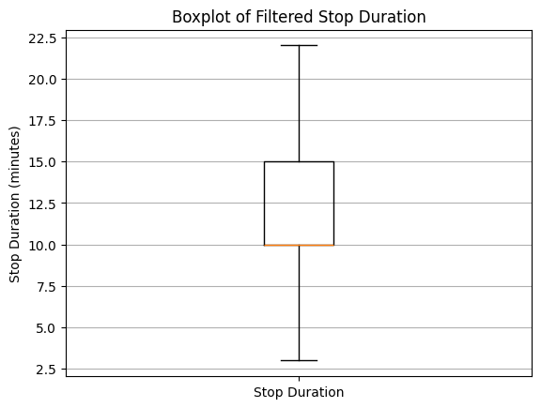
Observations:
In the BPD field activities dataset, we investigated the top 10 officers and supervisors who were most frequently involved in these field activities between 2011 and 2022. We also explored the distribution of the stop duration variable and, after removing outliers, found that the average stop time was approximately 11.17 minutes.

Slide 5
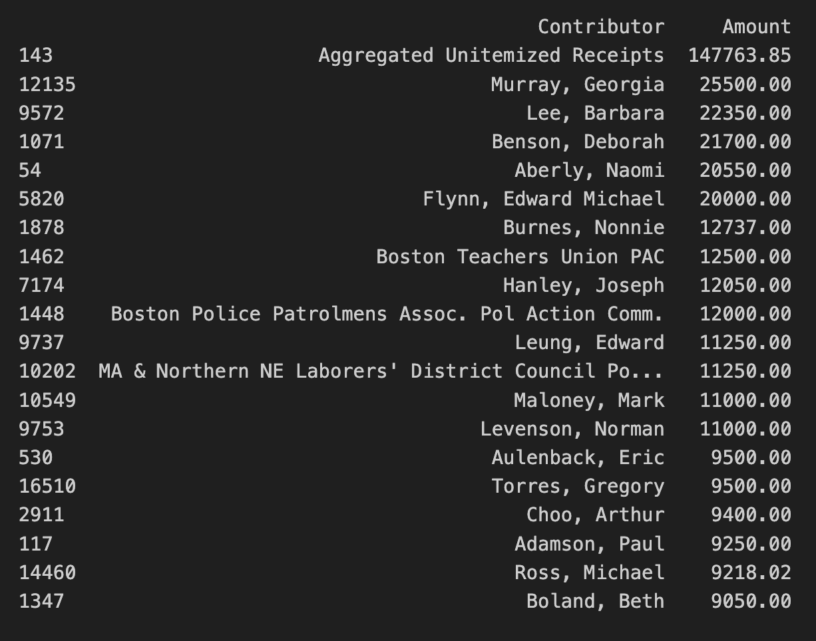
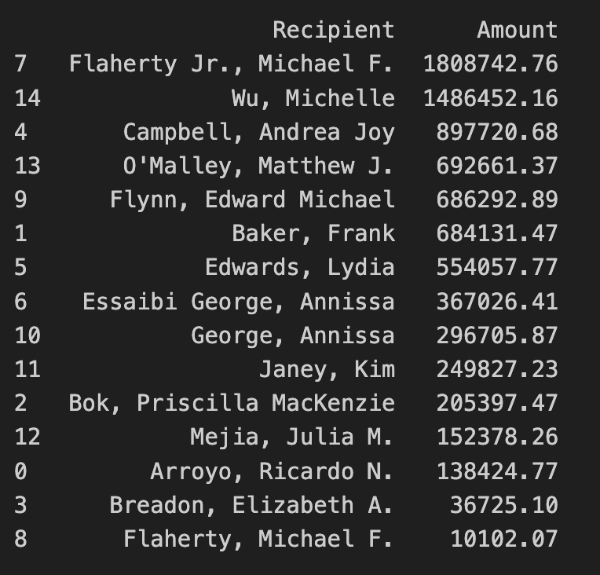
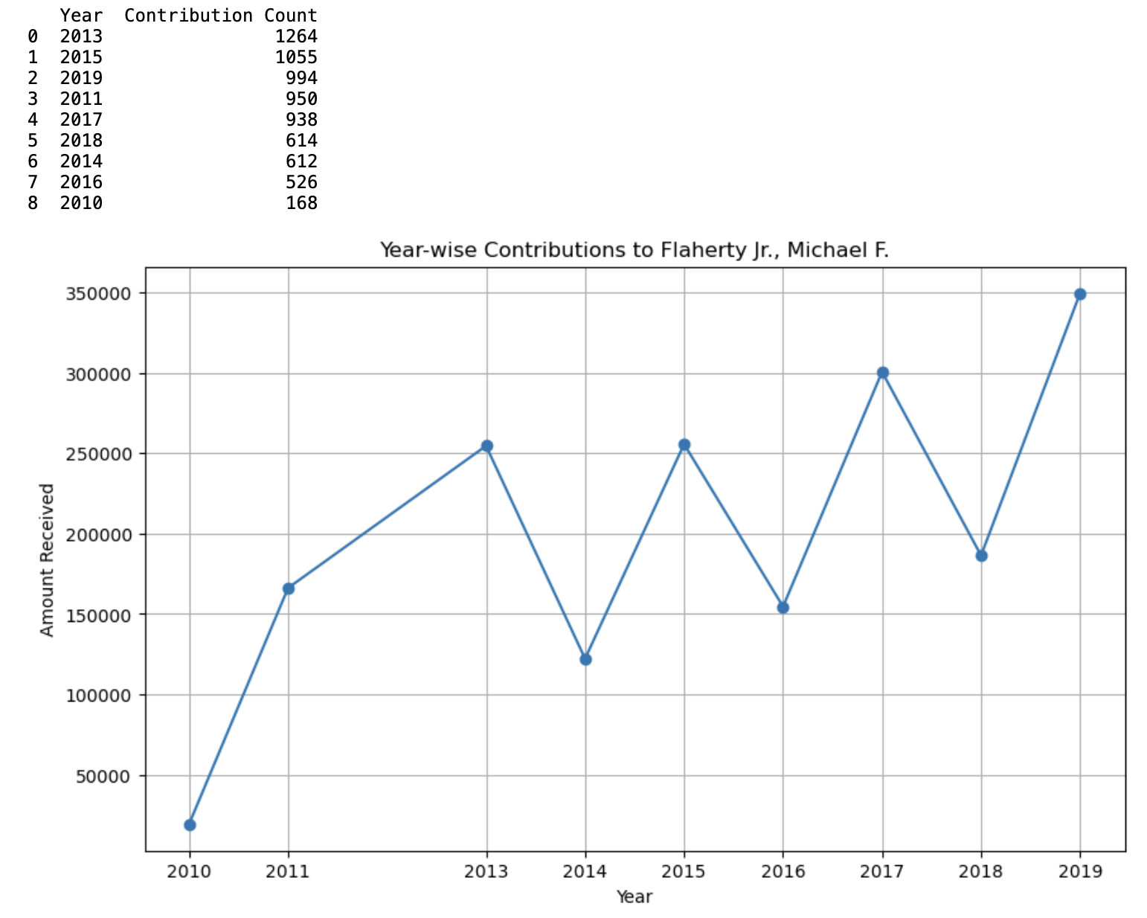
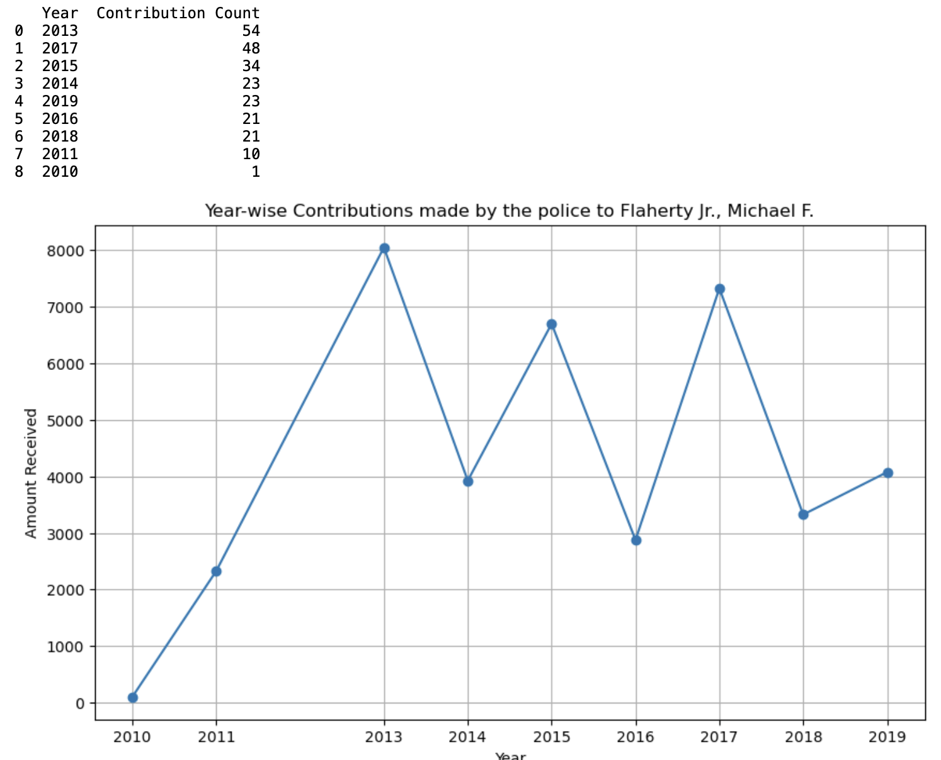
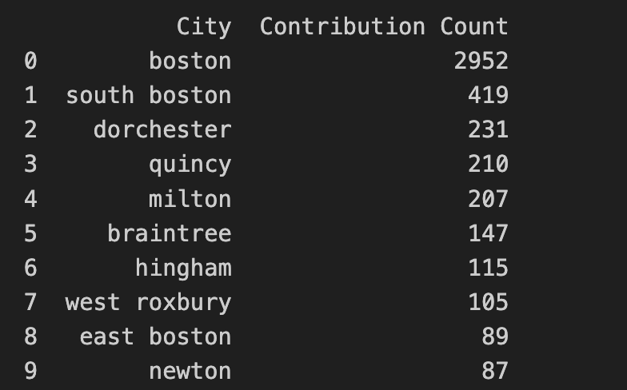
Observations:
In the Campaign Contribution Dataset we explored active CC contributions.
Fig: Top 15 CC recipients
Fig: Active CC contributors
Fig: Year-wise contributions to Flaherty Jr.
Fig: Cities from where Flaherty Jr. received his contributions
Fig: Year-wise contribution by the Police

Slide 6
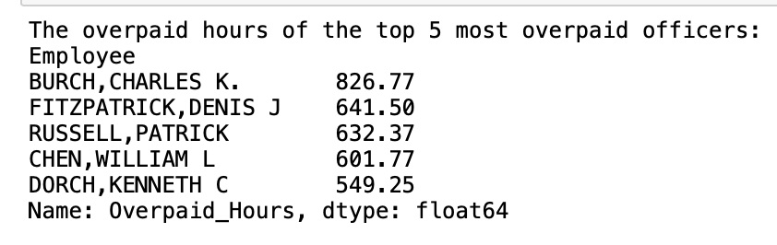
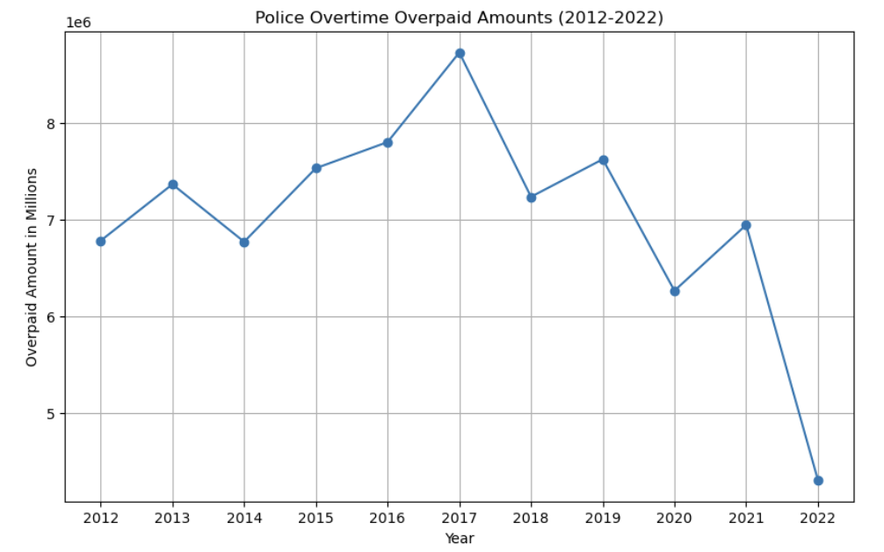
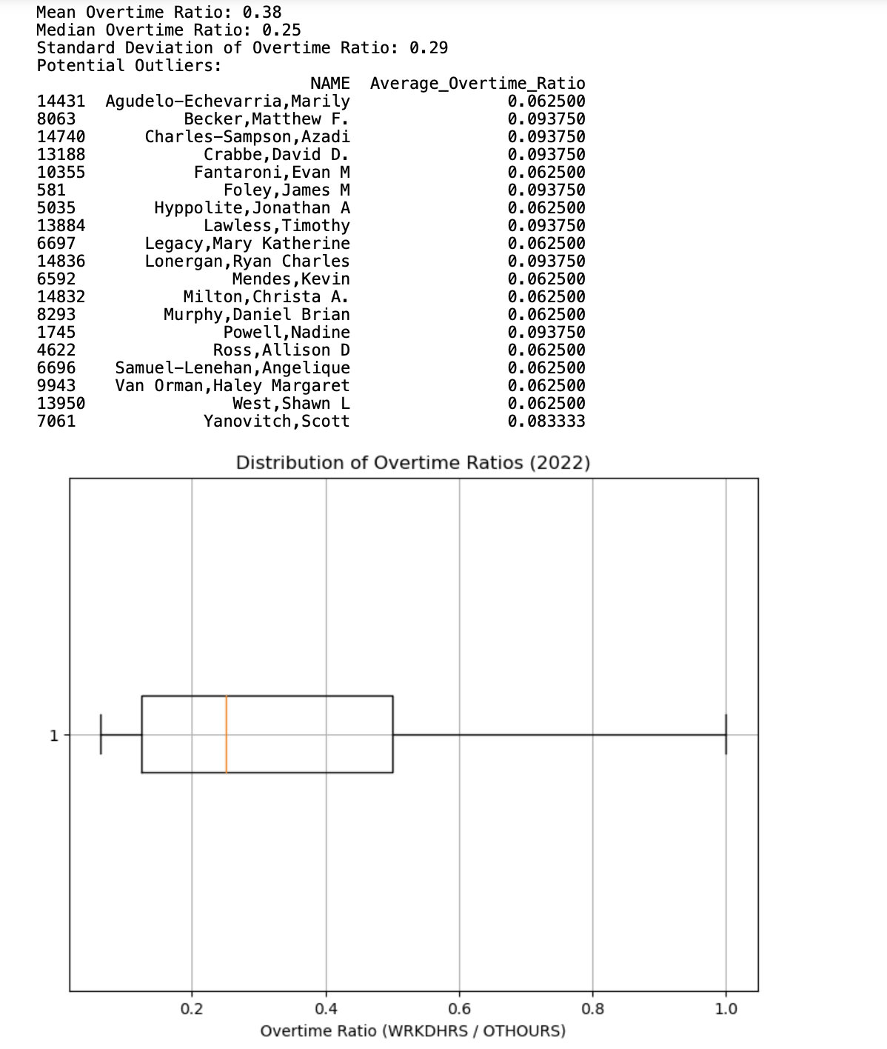
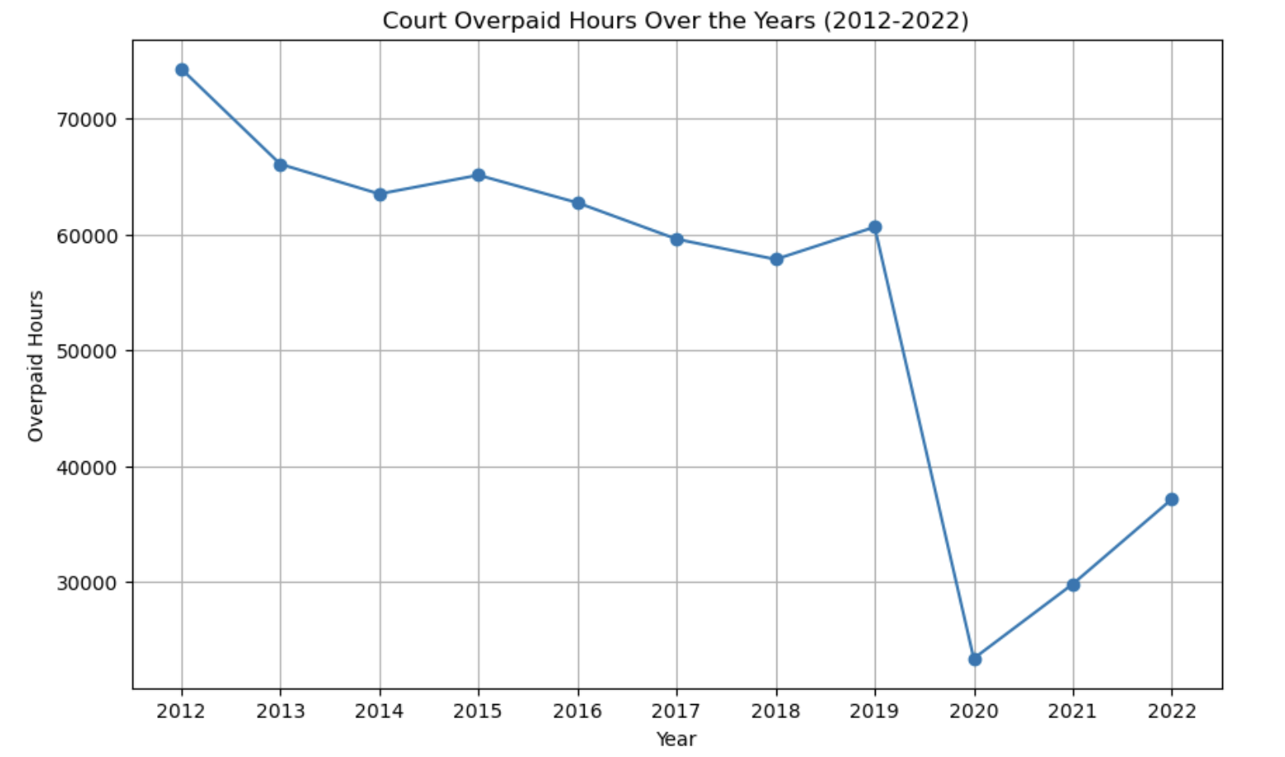
Observations:
We explored the Overtime dataset and answered all the base questions related to this dataset.
Fig: Finding the number of overpaid hours
Fig: Year-wise trend of how much the state could have saved
Fig: Ratio of OT worked Vs. OT paid and finding outliers
Fig: Trend of Court overpaid hours

Slide 7
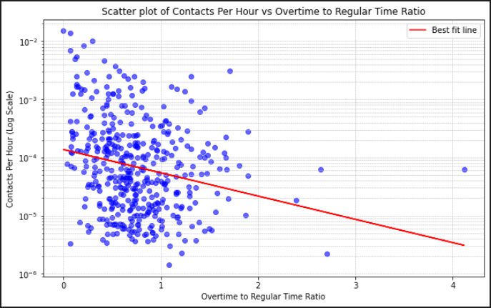
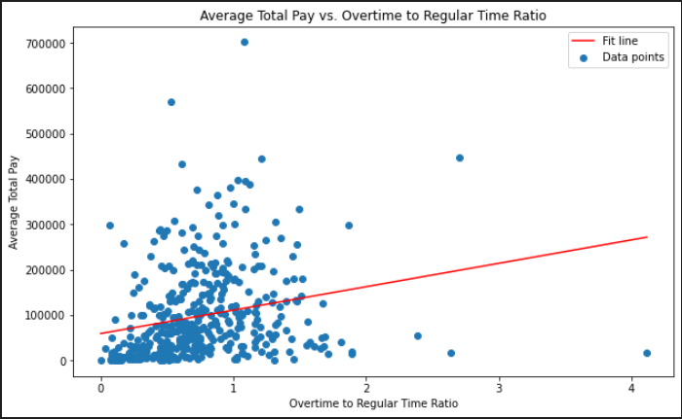
Observations:
In the interest of finding the economic usefulness of police overtime in the field, we graphed average pay over the 'overtime to regular time ratio' to compare with the perceived decrease in performance during overtime hours.
Fig: The contacts per hour for each officer as a function of the 'overtime to regular time ratio'
Fig: The average total pay for each officer as a function of the 'overtime to regular time ration'

Slide 8
Challenges and Limitations:
Are certain officers (e.g., white, old, male, long tenure, high ranking title) more likely than others to have lower worked-to-paid ratios? For this base question in the overtime dataset we have no mention about the age and ethnicity of the officers. Rank information is provided and we have visualized our findings based on rank.
Have previously been disciplined for overtime abuse or other misconduct? Yet again for this question we don’t have a dataset that has information on the officers that have been disciplined for overtime abuse or misconduct.

Slide 9
Conclusion:
Having Performed early analysis on the datasets provided to us, we aim to extend our work by finding more crucial insights and we will attempt to see if there’s a bridge between the different datasets.
We propose to answer all of the remaining project base questions too.
Finally, we plan to take inspiration from the other Police Overtime teams to help view our data from another perspective.

Slide 10
Extension Proposal:
In the overtime dataset, we have no mention about the age and ethnicity of the officers. If the stakeholders could provide us with a dataset that has this information, we could answer few of the base questions and hope to draw out more insights.
In the overtime dataset, we don’t have a dataset that has information on the officers that have been disciplined for overtime abuse or misconduct. If the stakeholders could provide us with a dataset of these records we could attempt to extract more information.
We already have visualized some important information from the campaign contributions dataset that are not part of the base questions. We could follow this up and find the big picture.

